Slide 1
Calculating gases in chemical reactions
Calculating gases in chemical reactions

Slide 2
Mass calculations based on amounts of products and reactants should be considered.
The calculations needed to use the mole relationships given by coefficients in a balanced chemical equation in order to determine amounts of reactants and products.
This relationship can now be extended to include volume of gases.

Slide 3
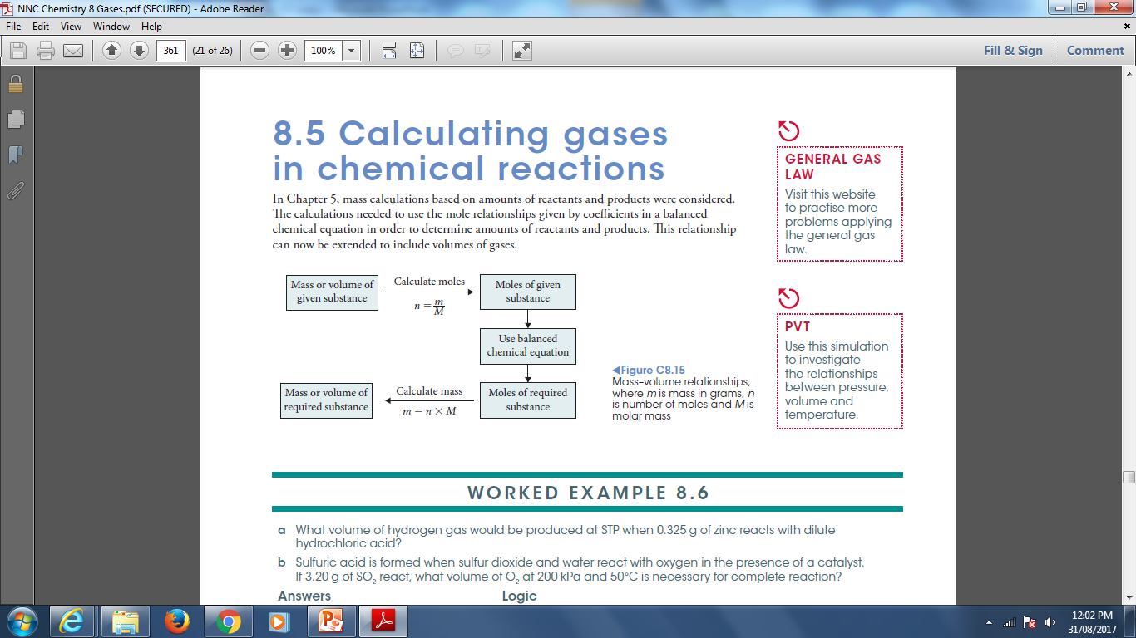

Slide 4
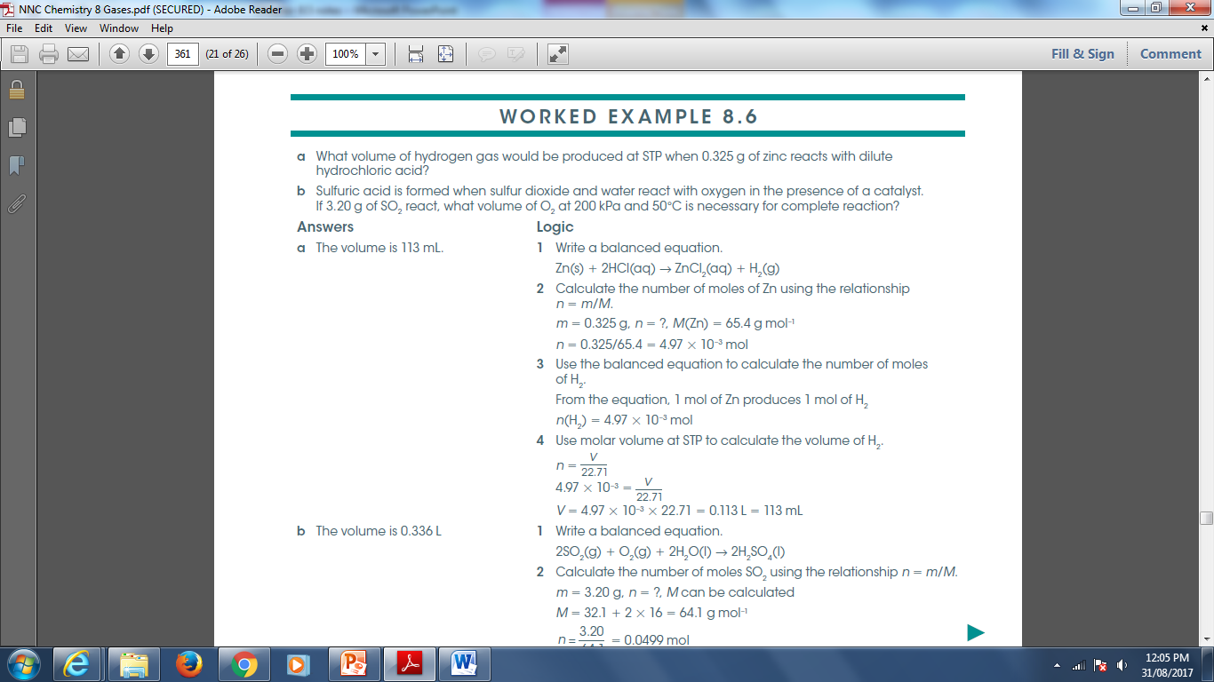

Slide 5
